Slide 1
Project Case 2 Information Broker INCA A Mobile phone based Intelligent Scoring Approach for assessment of critical Illness
Group 12
Kaavya Rekanar
Siva Venkata Prasad Patta
Sushmitha Donthula

Slide 2
Problem Description
The main objective of this project is to reduce the time required to report an accident and to determine its location more precisely using an artificially intelligent agent.
Lack of proper methods for a victim to contact help services.
Proposed system is an effective method to solve this problem.

Slide 3
Solution Method for DSS
Understanding packet loss behavior since loss can have a significant impact on the performance of both TCP- and UDP-based applications.
Then the message will be received by the service center using GSM modem.
Using the mobile number and tower location they identify accident location using latitude and longitude.
Then they inform the type of the accident and appropriate location to the nearby service (police & fire).

Slide 4
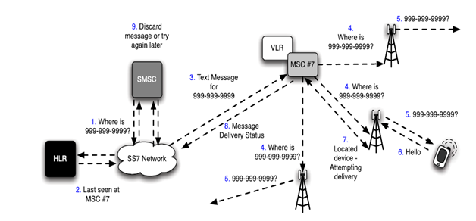
Architecture of the proposed system

Slide 5
Design
Analytical design is implemented and is represented using various use-cases.
The phases involved includes
Phase 1: Intelligent phase
Phase 2: Design phase
Phase 3: Choice phase
Phase 4: Implementation phase
Phase 5: Feedback and Monitoring phase.

Slide 6
Implementing DSS
A Traffic Controlling Agent is used to receive the messages sent by the victim.
The system uses
Communication driven DSS
Data driven DSS
Knowledge driven DSS

Slide 7
Model
The system incorporates various models.
Analytical model
Tactical model
Operational model

Slide 8
Simulation of Results

Slide 9

Questions?

Slide 10
Thank You

